Slide 1

Communication Protocols : UART/USART
By : Ahmad Hazem

Slide 2
What is a communication Protocol ?

Slide 3
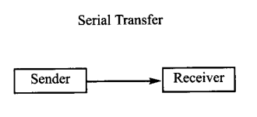
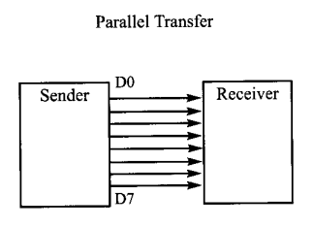
Serial vs Parallel Connection
Advantages :
Cheap
Less chance of data distortion at long distances up to 10m
Simple Connection
Easy in error detection
Disadvantages :
Slow
Size of the data in the frame is limited.
Advantages :
Very Fast
Disadvantages :
Expensive
Requires a lot of pins
Only for short distances
Data can be easily distorted
Complex
Error cannot be detected easily

Slide 4
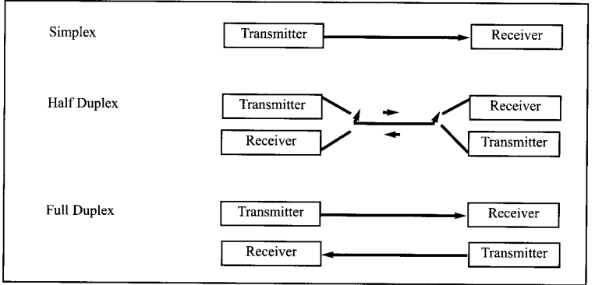

Slide 5
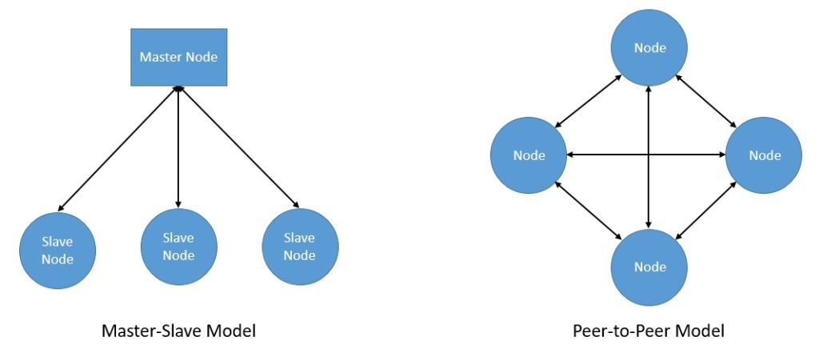
Master to slave communication vs Peer to peer communication

Slide 6
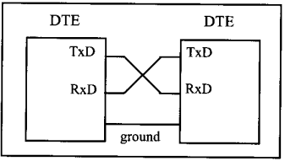
UART/USART -> Peer to peer communication -> Serial Communication

Slide 7
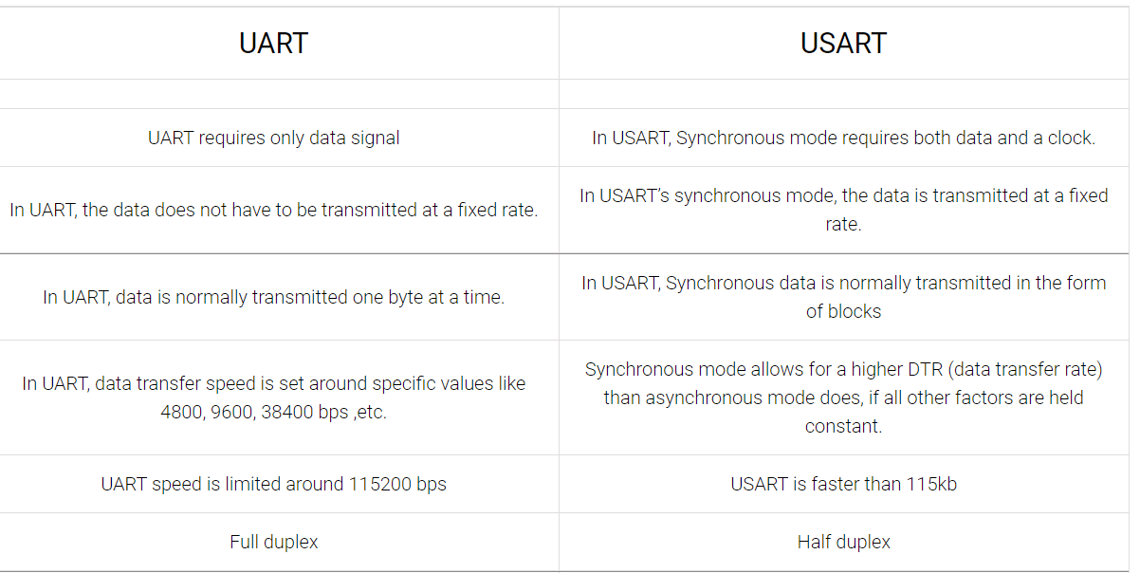
Full duplex

Slide 8
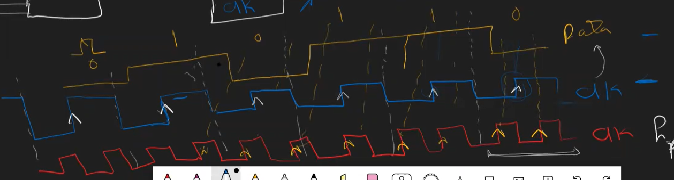

Slide 9
UART/USART registers
UCSRA (USART Control Status Register A)
UCSRB (USART Control Status Register B)
UCSRC (USART Control Status Register C)
UDR (USART Data Register)
UBRR (USART Baud Rate Register)

Slide 10
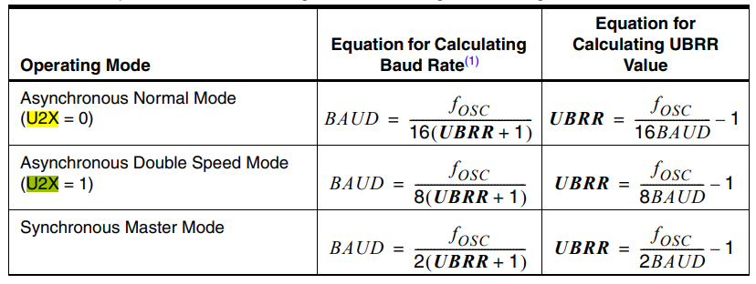
UBRR (USART Baud Rate Register)

Slide 11
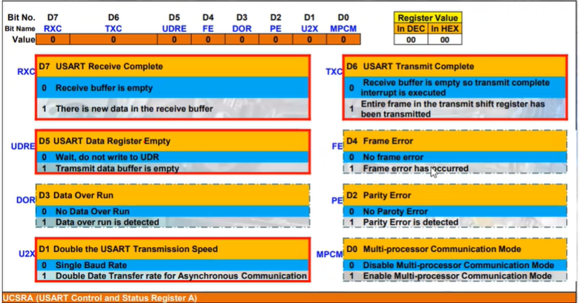

Slide 12
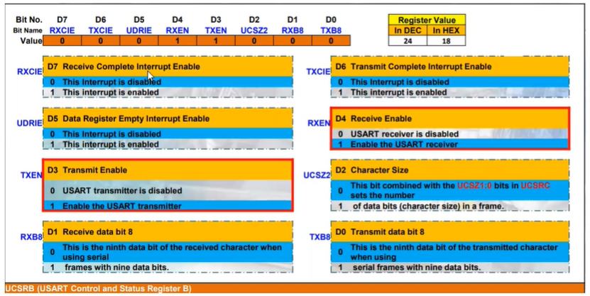

Slide 13
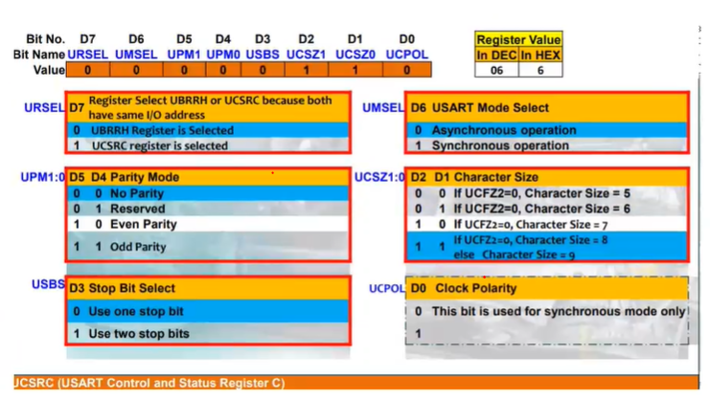
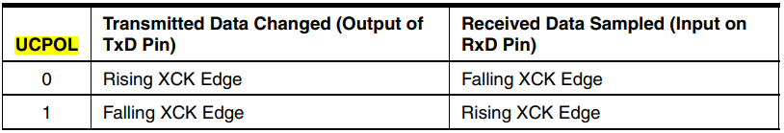

Slide 14
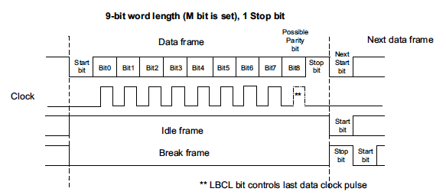
USART/UART frame

Slide 15
